Slide 1
TIC TAC TOE
Presented by
THAPA ARJUN
M22W0385

Slide 2
CONTENT
INTRODUCTION
FEATURE
OBJECTIVE
SCREENSHOT
CONCLUSION
REFRENCES

Slide 3
INTRODUCTION
Tic-tac-toe, also known as Noughts and crosses or Xs and Os, is a simple and classic game that can be played by people of all ages. The game is played on a 3x3 grid, where players take turns placing their symbols, either X or O, on the grid. The goal of the game is to get three of your symbols in a row horizontally, vertically, or diagonally, before your opponent does. The game is easy to learn, with simple rules and a straightforward objective, making it a popular choice for passing time and enjoying with friends and family. It is also a popular choice as a tool for teaching basic strategic concepts in game theory.

Slide 4
FEATURE
Tic-tac-toe is a simple game that can be played on a 3x3 grid.
The goal of the game is to get three of your symbols (either X or O) in a row, either horizontally, vertically, or diagonally.
Basic opponent AI
Simple interface
Nice graphics
The game can be played with two players, or one player can play against a computer.

Slide 5
OBJECTIVE
The objective of Tic-tac-toe is to get three of your symbols (either X or O) in a row horizontally, vertically, or diagonally on a 3x3 grid.
The first player to achieve this wins the game.
If all the spaces on the grid are filled and no player has three in a row, the game is a draw.
The game is often used as a simple pastime or a tool for teaching basic strategic concepts in game theory.

Slide 6
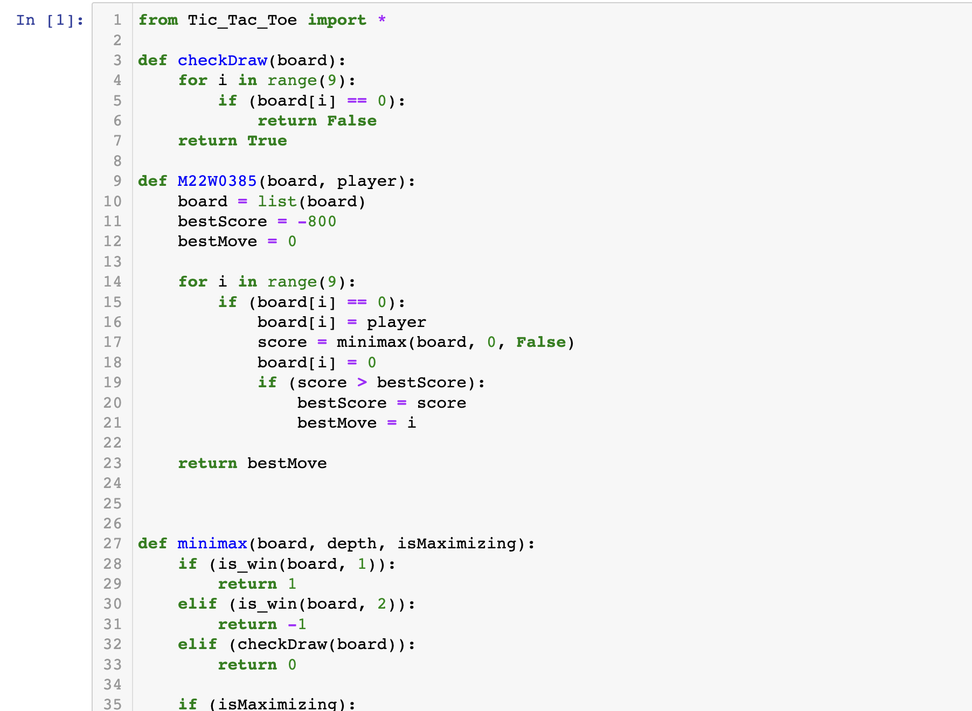
SCREENSHOT

Slide 7
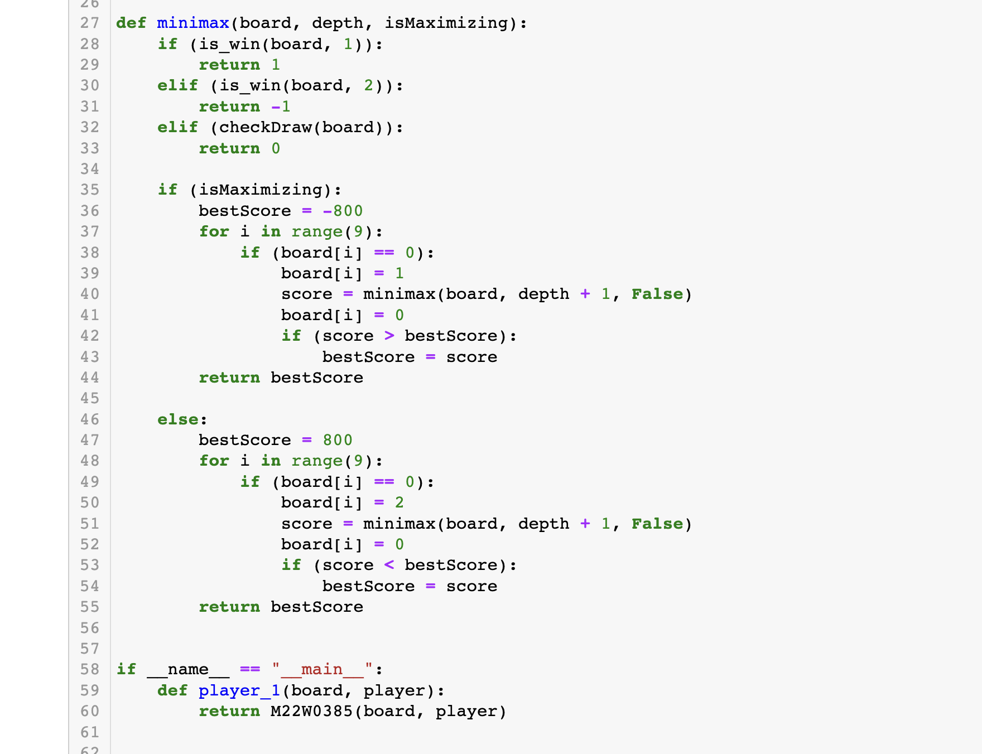
SCREENSHOT

Slide 8
CONCLUSION
Tic-tac-toe is a simple but classic game that can be played by people of all ages. It is easy to learn but can also be used to teach basic strategic concepts in game theory. The objective of the game is to get three of your symbols in a row horizontally, vertically, or diagonally on a 3x3 grid. The game can be played with two players, or one player can play against a computer. It is a perfect game for passing time and enjoying with friends and family.

Slide 9
REFERENCES
http://www.newbreedsoftware.com/ttt/features/
https://www.ncbi.nlm.nih.gov/pmc/articles/PMC2274964/ - :~:text=Tic Tac Toe is traditionally,vertically, horizontally, or diagonally.

